Slide 1
Building Revitalization Collaborative (BRC)
February 11, 2015
Notes:
Please note:
Read the notes section of all slides for instructions regarding minimum and maximum font sizes for bullets within the presentation.

Slide 2
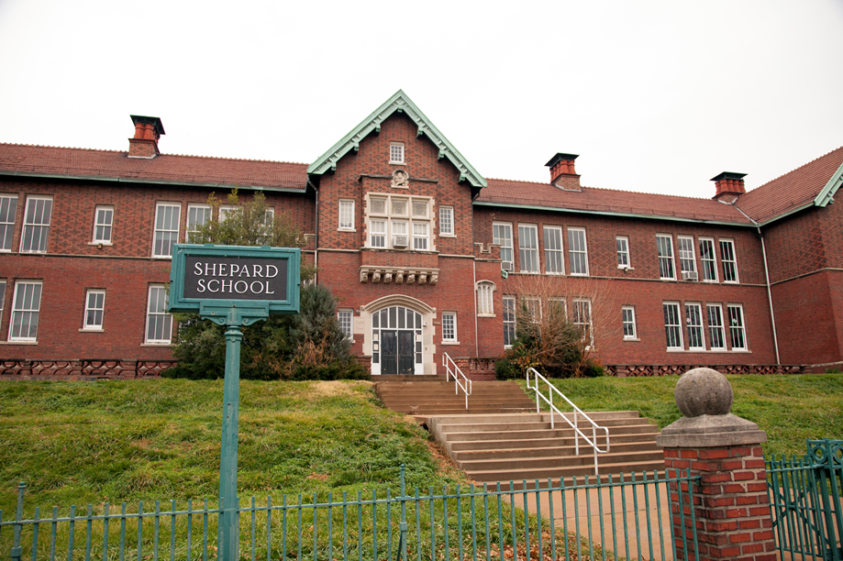
Overview
Develop community-driven revitalization strategies for the District’s closed schools
Promotes financial strength for the District
Promotes well-being of the community and neighborhoods
Recommend approval of the Building Revitalization Collaborative
Notes:
Please note:
The bullet points should be brief and include highlights.
There has been a tendency in the past for too much text that is then read word-for-word during the presentation.
The minimum font size for bullets should be Arial 20 or the maximum font size for bullets should Arial 24

Slide 3
Background
Enrollment has declined – down 37% since 1996
Driven largely by demographics, charter schools
District has closed 43 schools since 2003
District currently utilizing 67% open school capacity
Notes:
Please note:
The bullet points should be brief and include highlights.
There has been a tendency in the past for too much text that is then read word-for-word during the presentation.
The minimum font size for bullets should be Arial 20 or the maximum font size for bullets should Arial 24

Slide 4
Current Situation
42 schools sold since 2003:
2003 – 2004: 21
2005 – 2007: 12
2008 – 2012: 9
Using professional real estate services
Current inventory – 35 closed schools
26 listed for sale
4 currently under contract
Closed schools deteriorate rapidly
Revitalization of closed schools benefits neighborhoods
Notes:
Please note:
The bullet points should be brief and include highlights.
There has been a tendency in the past for too much text that is then read word-for-word during the presentation.
The minimum font size for bullets should be Arial 20 or the maximum font size for bullets should Arial 24

Slide 5
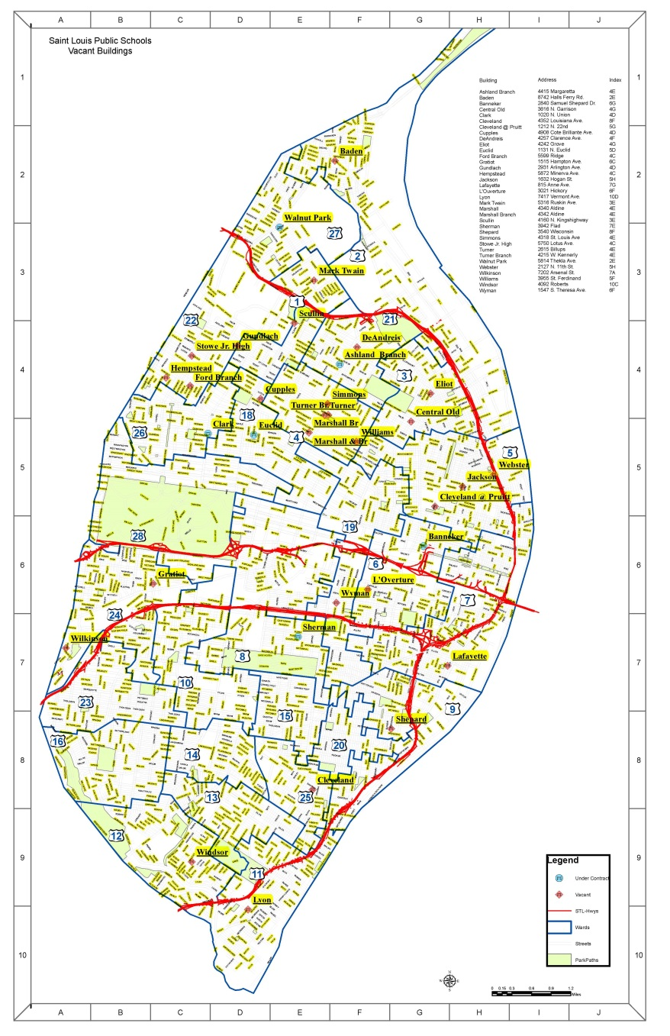
35 Closed School Sites
Ashland Branch
Baden
Banneker
Central Old
Clark
Cleveland Old
Cupples
DeAndreis
Eliot
Euclid+
Ford Branch
Gundlach
Gratiot
Hempstead
Jackson
Lafayette+
L’Ouverture*
Lyon
Mark Twain
Marshall
Marshall Branch
Pruitt*
Scullin
Sherman+
Shepard
Simmons
Stowe
Turner
Turner Branch
Walnut Park
Webster
Wilkinson
Williams
Windsor+
Wyman*
* Reuse plans in development
+ Under Contract
xx
Notes:
Please note:
The bullet points should be brief and include highlights.
There has been a tendency in the past for too much text that is then read word-for-word during the presentation.
The minimum font size for bullets should be Arial 20 or the maximum font size for bullets should Arial 24

Slide 6
Proposal
Create Building Revitalization Collaborative
A public-facing platform engaging Community Stakeholders and Technical Advisory Committee (TAC)
35 Closed schools
Public
Technical Advisory Committee (TAC)
Community Stakeholders
Architects, Builders, Developers, Preservation, Finance, etc.
35 Building Plans
Notes:
Please note:
The bullet points should be brief and include highlights.
There has been a tendency in the past for too much text that is then read word-for-word during the presentation.
The minimum font size for bullets should be Arial 20 or the maximum font size for bullets should Arial 24

Slide 7
Building Revitalization Process
Phase I Site Tours March – May 2015 | Phase II Community Forums June – August 2015
Phase III Action Plan Development August - September 2015 | Phase IV Action Plan Implementation October 2015 and onward
Notes:
Please note:
The bullet points should be brief and include highlights.
There has been a tendency in the past for too much text that is then read word-for-word during the presentation.
The minimum font size for bullets should be Arial 20 or the maximum font size for bullets should Arial 24

Slide 8
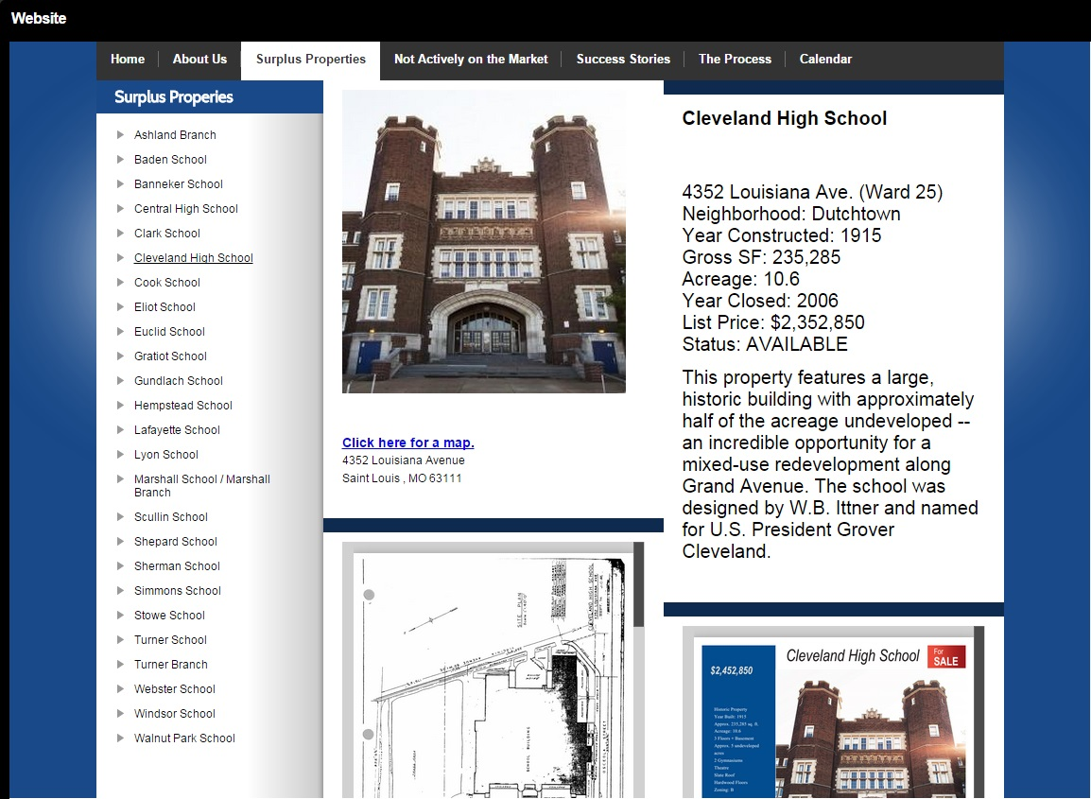
Enhanced Website
To Include:
Mission/ Guiding Principles
Page for each Closed School
Community Feedback
Closed School Action Plans
Progress
Notes:
Please note:
The bullet points should be brief and include highlights.
There has been a tendency in the past for too much text that is then read word-for-word during the presentation.
The minimum font size for bullets should be Arial 20 or the maximum font size for bullets should Arial 24

Slide 9
Pros and Cons
Pros
Spotlights what we are doing right
Enhances effort
Publicizes
Invites fresh perspectives
Involves community stakeholders
Utilizes internal SLPS resources
Cons
Community wishes may not match TAC guidance
Potential costs for implementation
Time commitment for TAC members
Notes:
Please note:
The bullet points should be brief and include highlights.
There has been a tendency in the past for too much text that is then read word-for-word during the presentation.
The minimum font size for bullets should be Arial 20 or the maximum font size for bullets should Arial 24

Slide 10
Next Steps
SAB approval of Building Revitalization Collaborative
Recruitment of Technical Advisory Committee members
Complete web and content development
Public outreach via multi-media
Begin phased process
Phase I – Site tours (March – May 2015)
Phase II – Community Forums (June – August 2015)
Phase III – Action Plan Development (August – September 2015)
Phase IV – Action Plan Implementation (October 2015 and beyond)
Notes:
Please note:
The bullet points should be brief and include highlights.
There has been a tendency in the past for too much text that is then read word-for-word during the presentation.
The minimum font size for bullets should be Arial 20 or the maximum font size for bullets should Arial 24

Slide 11
Questions?

